Slide 1
A Novel, Supervised Learning Approach to Autonomous Agent Design within a Multi-Agent Game
Ian Whitehouse
Inspired by A Path Towards Autonomous Machine Intelligence by Yann LeCun

Slide 2
Motivations
“[Intelligent agents are] anything that can be viewed as perceiving its environment through sensors and acting upon that environment through actuators” - Artificial Intelligence: A Modern Approach
  This is the original problems within computer science
Applications of autonomous agents include autonomous vehicles (ships, aircraft and cars) and robotic planning systems
  These systems are important for military and civilian applications. The size of the autonomous vehicle market alone is trillions of dollars
The eventual goal of the development of these agents is artificial general intelligence, a model that can reason, plan, and achieve goals within a multitude of domains

Slide 3
Model Design

Slide 4
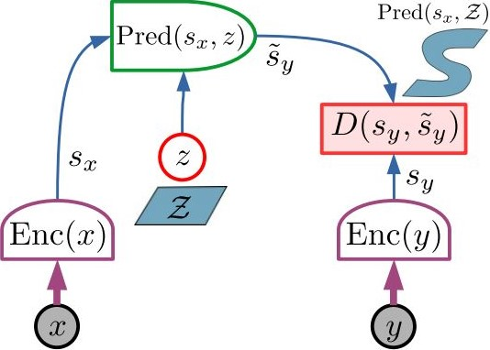
Inspiration
This project was inspired by Yann LeCunn’s essay “A Path Towards Autonomous Machine Intelligence”
This project discusses the creation of an autonomous agent largely based on his JEPA model, shown here.
This model simplifies the task of prediction by predicting the latent outputs of an encoder
  Ideally, the encoder removes extraneous information, allowing the predictor to focus on only necessary information

Slide 5
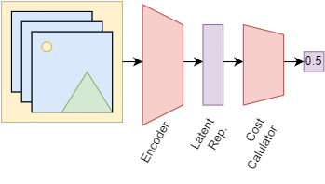
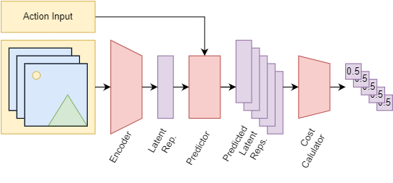
Training the Autonomous Agent
The autonomous agent consists of 3 neural networks
  The encoder converts images to latent representations
  The cost calculator uses latent representations to calculate the agent’s discomfort
  The predictor takes a latent representation and an input and calculates possible future latent representations
During training, the two stages above are run once for each batch of data.
  The first (left) trains the encoder and cost calculator to accurate calculate discomfort
  The second (right) freezes the cost calculator’s weights and trains the encoder and predictor to predict future latent representations

Slide 6
Experimental
Results
Multi-Agent Tag Game

Slide 7
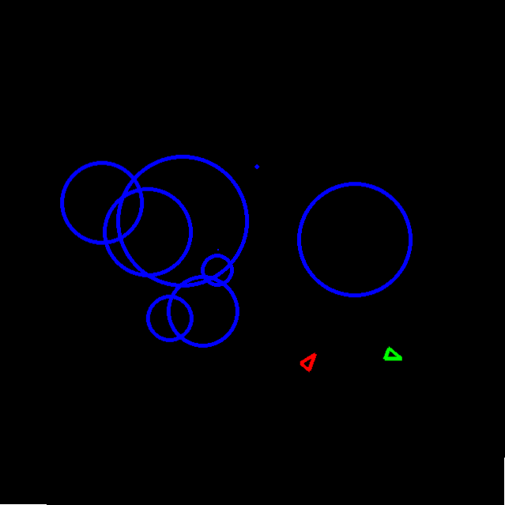
Multi-Agent Tag Game
To test my model, I designed a complex, multiagent environment: a two-player tag game that included obstacles to avoid
The model’s goal is either to move toward or away from the other player, and to avoid obstacles
This environment is intentionally visually-simple, yet it features a reasonable layer of strategic depth

Slide 8
Results Setup
For this project, I used a generation system where each generation was trained on the output of the previous one
Generation 1 was trained on the outputs of an agent that acted completely randomly
Each generation was trained on between 9000-15000 frames of gameplay over 126 games
  That’s between 7.5 minutes and 12.5 minutes, which is much less data than would be required of an equivalent reinforcement learning agent

Slide 9
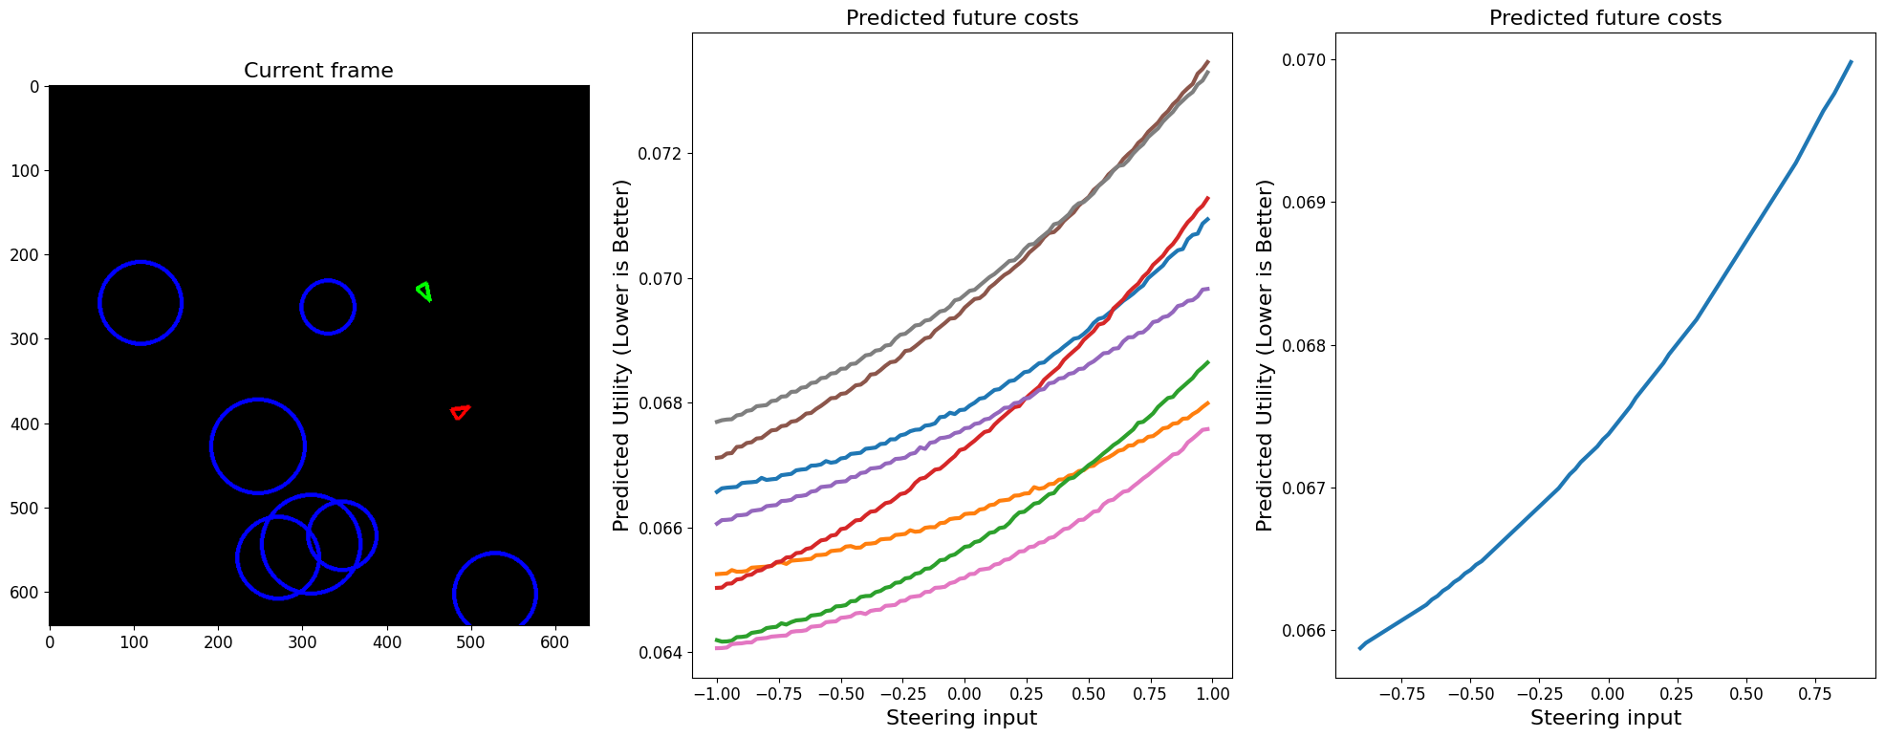
Generation 1 – Example of Model Inference
This graphic shows, from left-to-right, the tagger (red) model’s input, its expected costs (y-axis) vs the turning input it makes (x-axis) for each possible future, and the average of the futures. The minimum of the average of the estimated costs being on the left will cause the model to turn left.

Slide 10
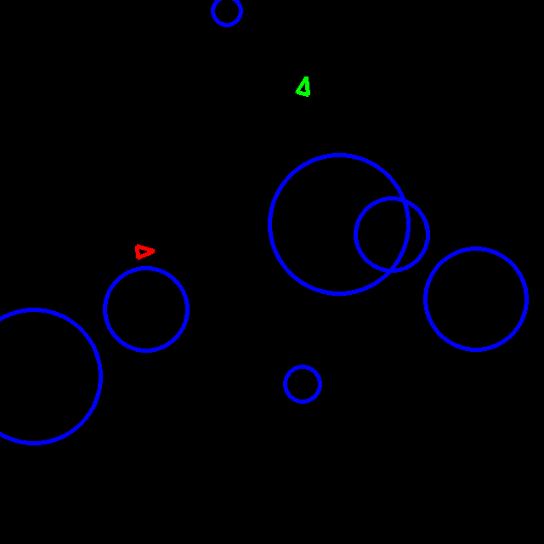
The first-generation model acts confused, but its behavior is far from random
Here, the tagger (red) seeks out the taggee (green)

Slide 11
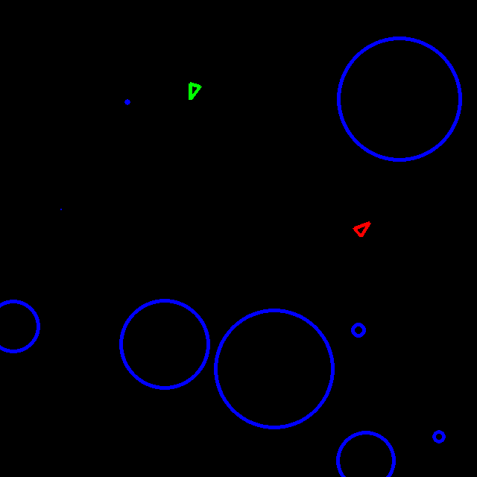
The first-generation model acts confused, but its behavior is far from random
Here, the tagger (red) seeks out the taggee (green)
Here, the tagger (red) moves between two obstacles (blue circles)

Slide 12
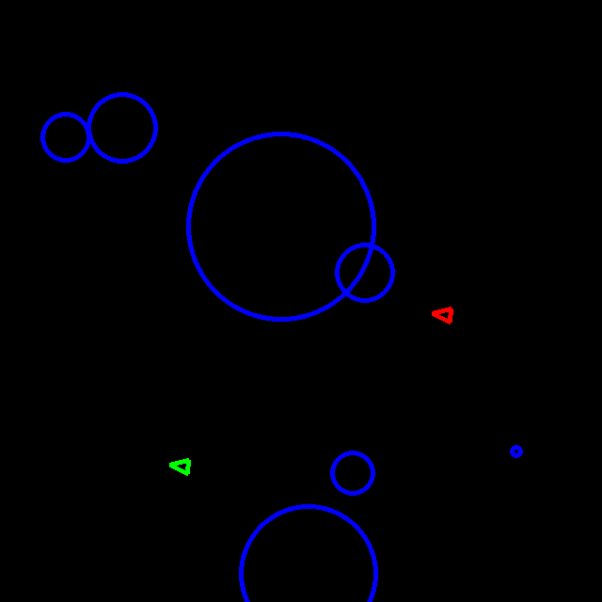
The first-generation model acts confused, but its behavior is far from random
Here, the tagger (red) seeks out the taggee (green)
Here, the tagger (red) moves between two obstacles (blue circles)
Here, the taggee (green) makes a clear effort to move away from the tagger (red), which eventually pushed it out of bound

Slide 13
Other generations had similar results to generation 1, but did not significantly improve
A flaw common between every generation was that agents tended to prefer to turn entirely right or left, and very rarely went straight
Agents in later generations began to favor repeatedly turning in circles, which shows they began to lose the ability to make complex decisions
  I find it interesting that, when trained on data that’s objectively better quality, the model got worse. This is a known issue with AI art models, which get worse when trained on AI art

Slide 14
Quantitative Results
In the simulated environment, the tagger model was slightly faster than the taggee. Therefore, in ideal play:
  The simulation lasts longer for the current generation than previous generations
  The tagger tags the other player more in the current generation than in previous generations

Slide 15
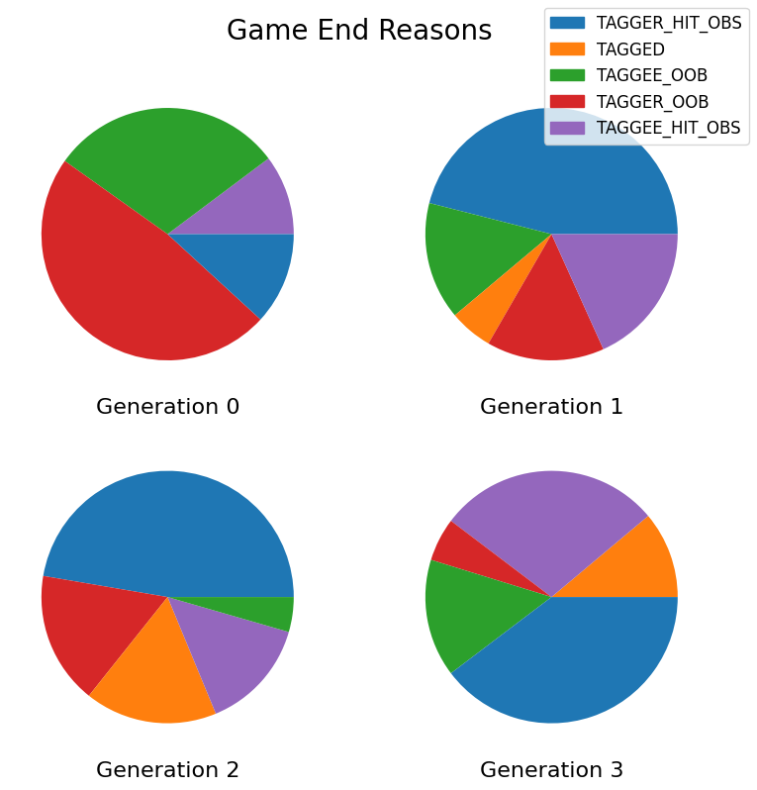
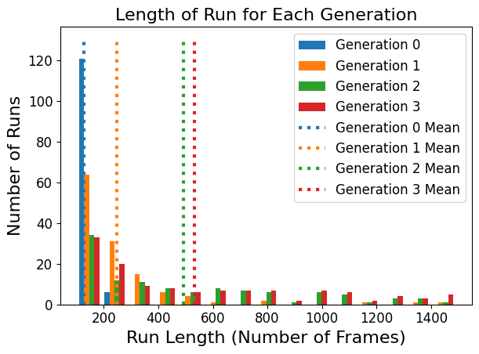
Each generation improves on these metrics, but the improvements peak with Generation 2
Only includes runs that lasted between 100 and 1500 frames. Included a variety of temperature configurations

Slide 16
Conclusions

Slide 17
This decision-making model shows promise despite clear flaws
The model learned to play complex, adversarial games in very little time
  This is a clear benefit of this approach over reinforcement learning, which plays a game hundreds or thousands of times during training
It is unclear whether this model could ever reach super-human capabilities, as it improved little after generation 2
Future research directions:
  Comparing this algorithm to common reinforcement learning algorithms
  Improving the training process to reduce the time required to train the algorithm
  Exploring the algorithm’s outputs to better understand the decisions it makes

Slide 18
Any Questions?

Slide 19
Cost-function creation is a challenge that was too complex to address this semester
Creating a cost function must balance short and long term goals. The cost must also be clearly seen from the model’s visual input
Currently, the cost function is broken into two parts: the distance between the two players, and a scaled demerit if that simulation was lost
This seems to be a good approach: each agent moves relative to the other agent, while also not crashing into obstacles. This approach also seems applicable to other real-world problems (next slide)
In the future, I would like to experiment with removing the distance element of the cost function, so the model is just consistently penalized when it loses

Slide 20
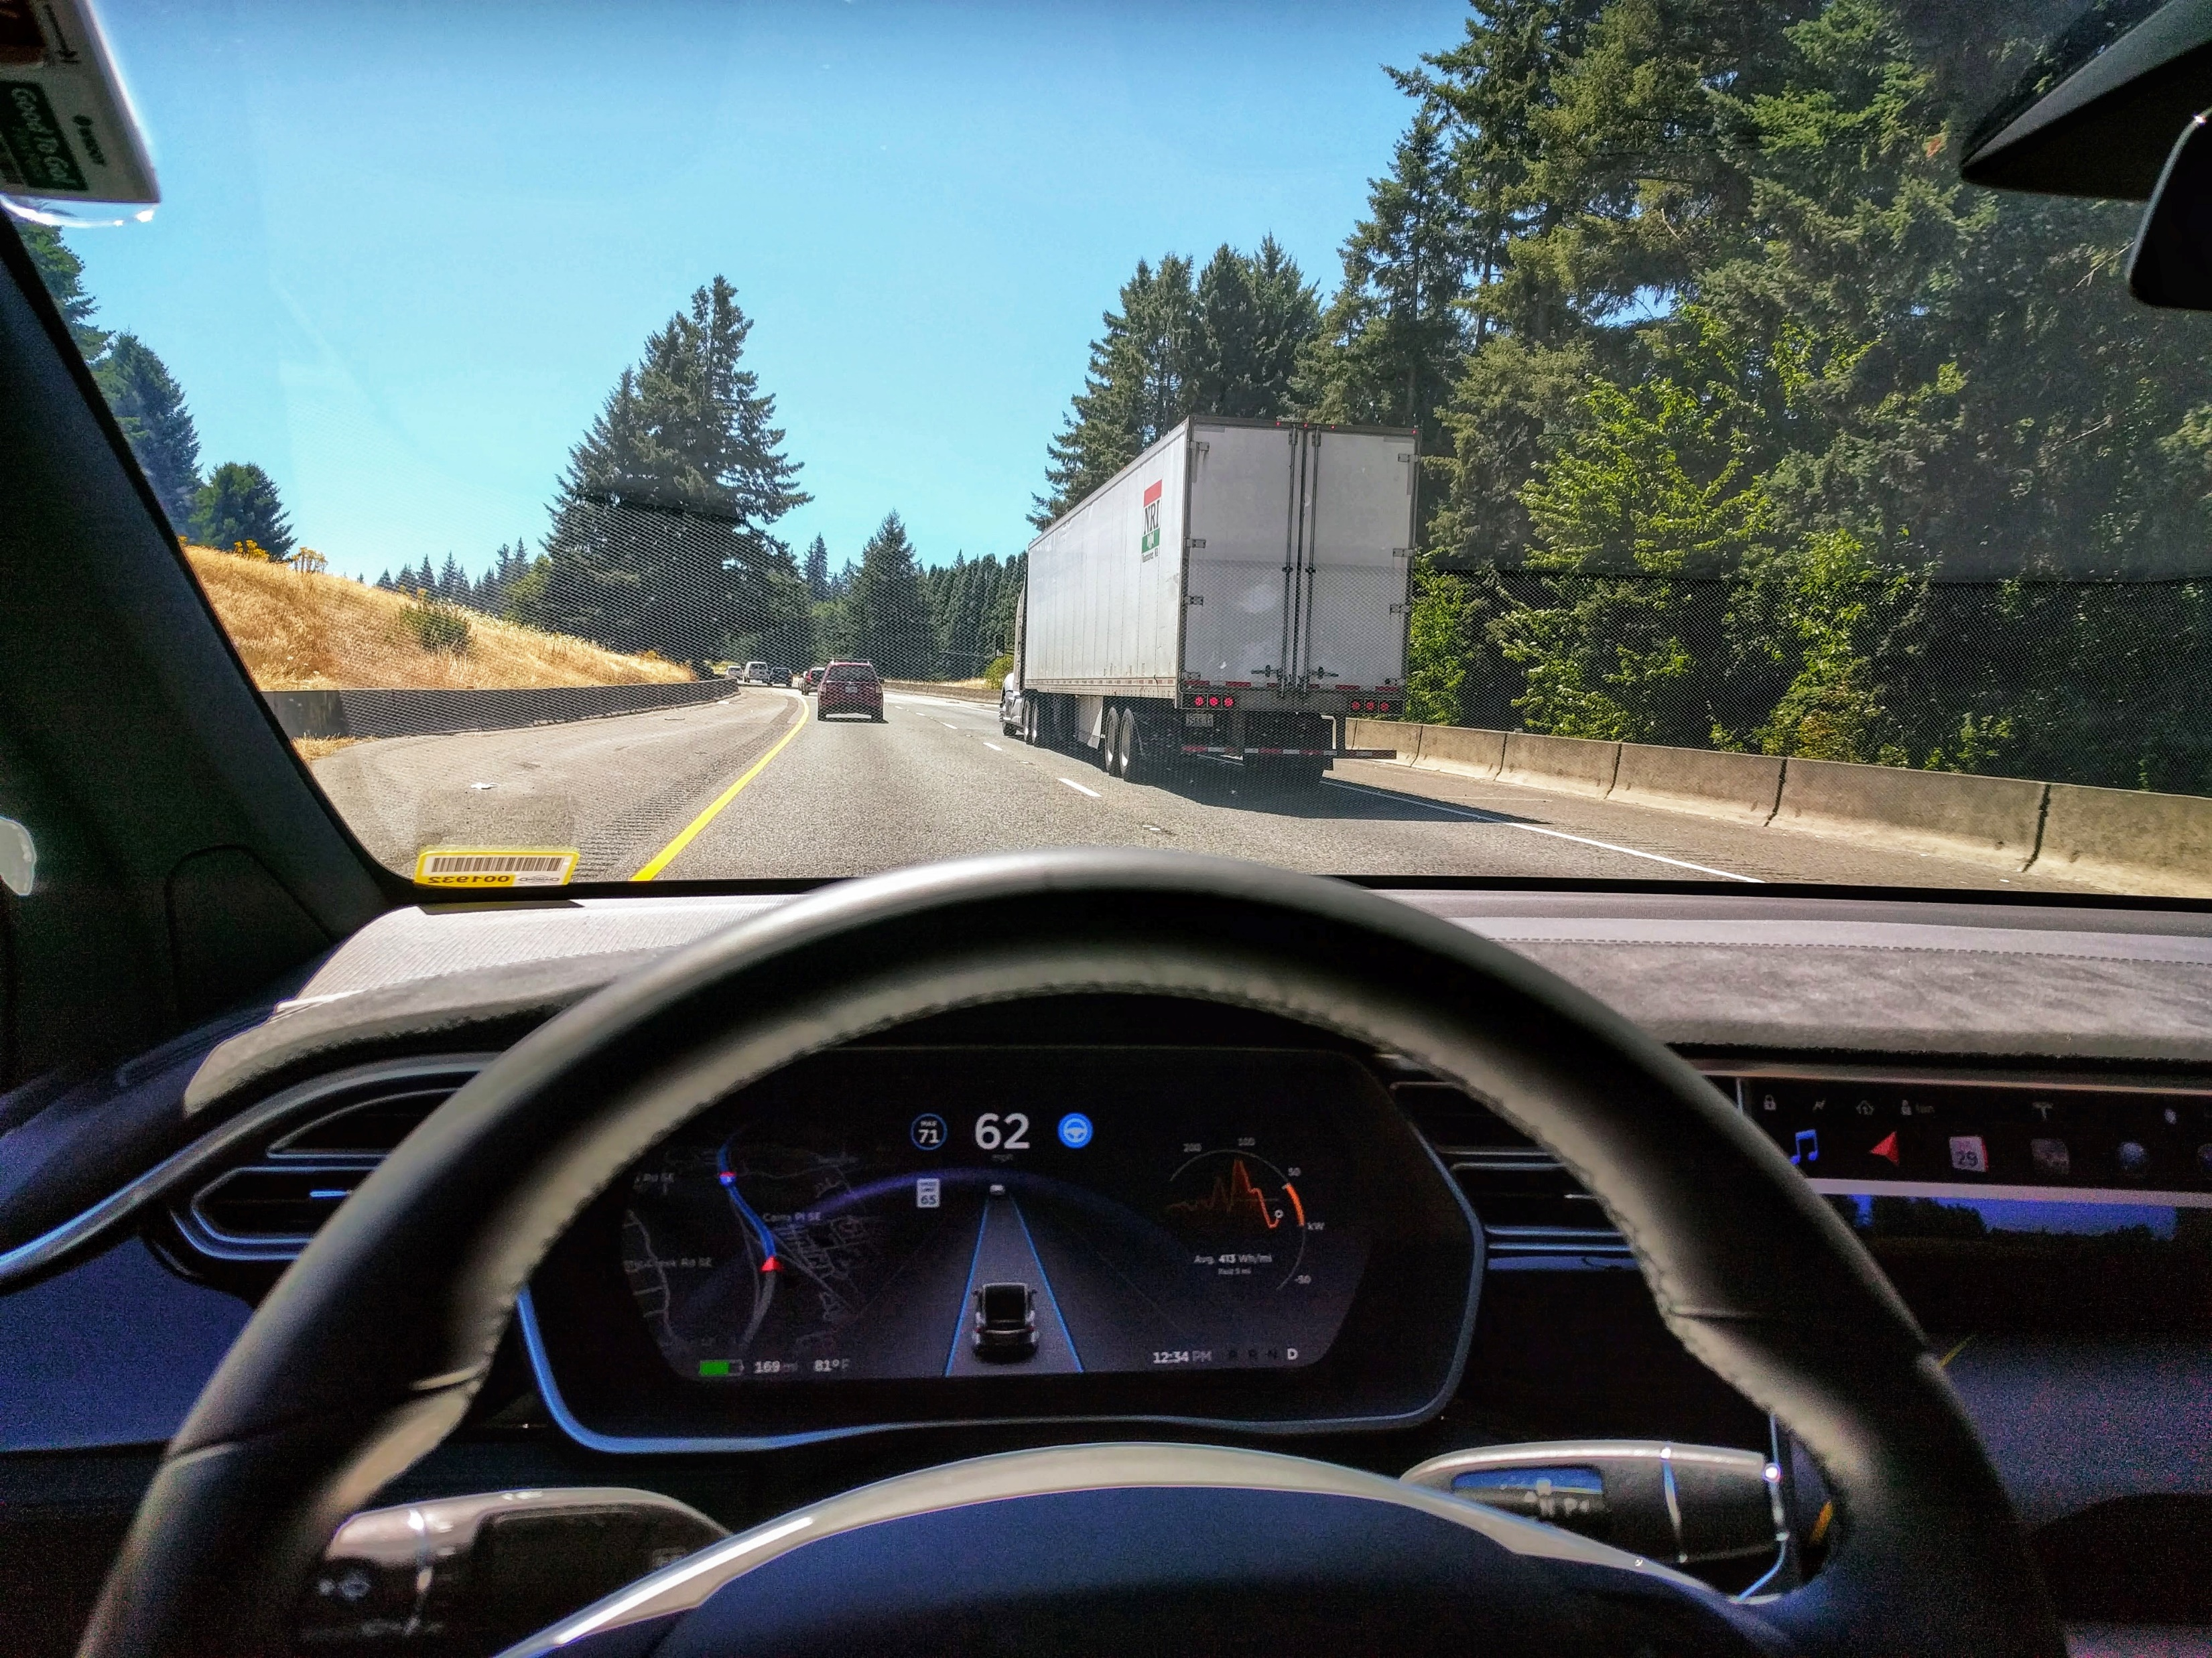
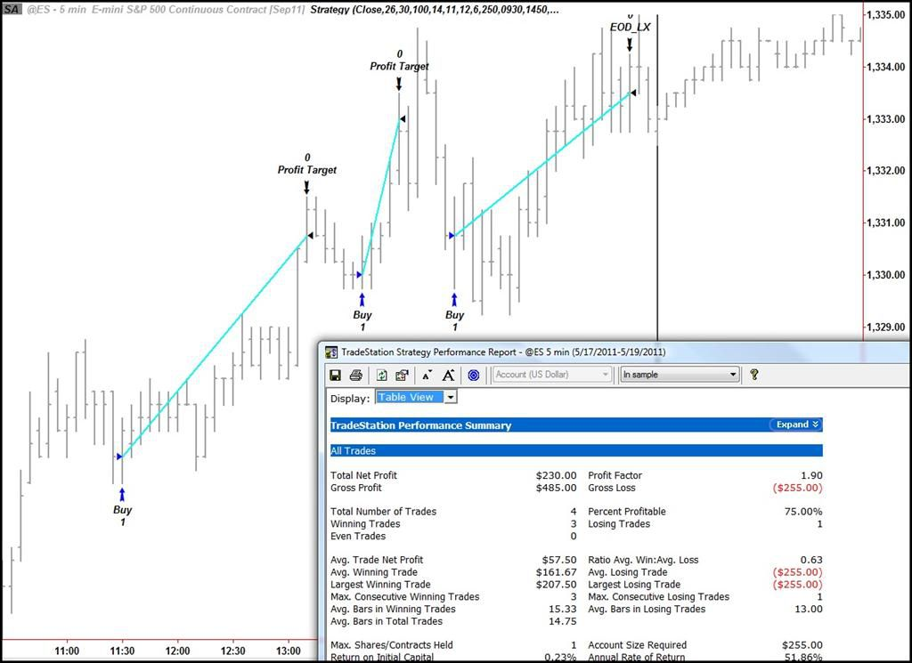
Real world examples that could have a similar cost function
Lane-Keeping Assist (LKAS): The cost function could be the distance to the center of the lane with a demerit for leaving the lane
Automated Stock Trading: The cost function could be the return of the portfolio with a demerit for selling before a set amount of time

